Slide 1

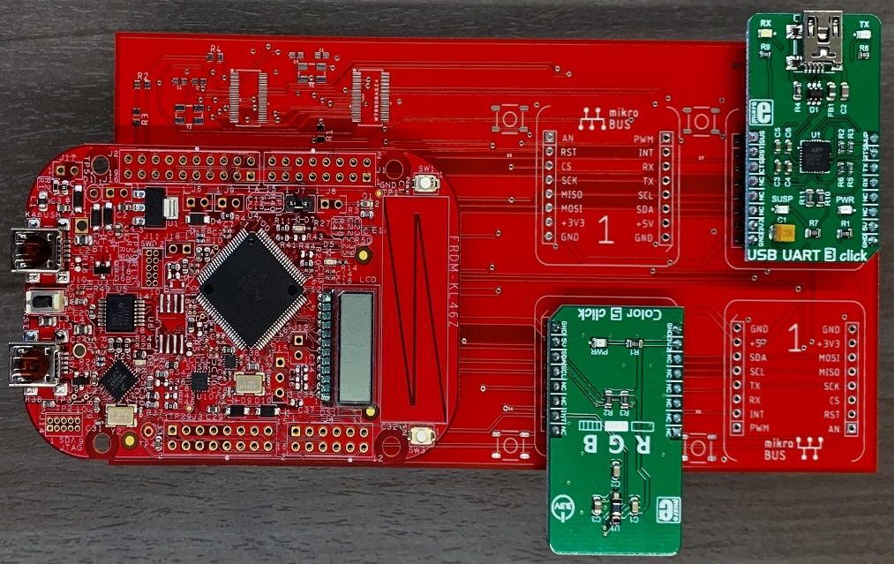

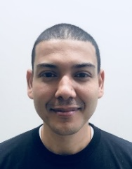
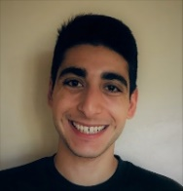
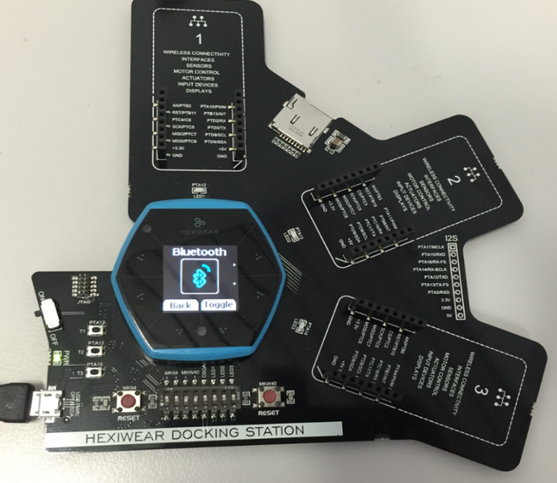

Team 2.08 CLICK SENSOR HUB
TEAM MEMEBERS:
Alfonso de la Morena [PM]
Mohamed Sghari
Dylan Dean
Sponsor:
Dr. Kevin Kemp, NXP
Faculty Advisor:
Dr. William Stapleton, TXST
Presentation Schedule:
I: Context
II: Overview
III: Hardware
IV: Software
V: Results
ELEVATOR PITCH STARTS ON THIS SLIDE
Notes:
Pitch
The PM starts the presentation then turns it over to others who speak in turn
Each person should introduce themselves and speak to the design and status of their subsystem
My name is Dylan Dean, I am the Software Engineer and currently…
My name is Alfonso de la Morena, I am the Project Manager and currently…
My name is Mohamed Sghari, I am the Hardware Engineer and currently…

Slide 2
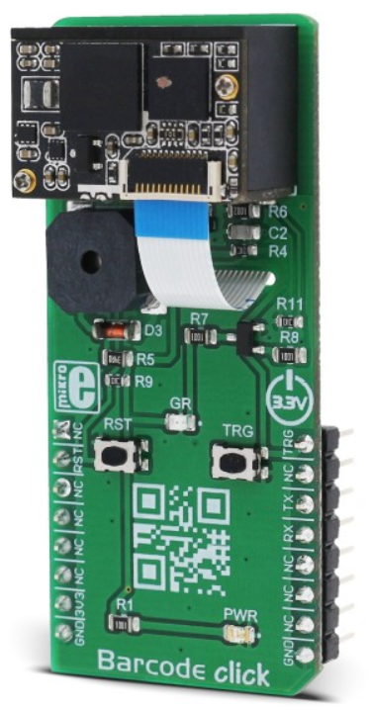
What are Clicks?
Barcode click
Click add-on boards are the easiest way to add sensors, human interfaces, controls, and wireless communications to your IoT development projects
Designed around the mikroBUS interface standard, click boards add vast customization options to any system with ease
Click Standard | Connection Type
GND | Shared
3.3V and 5V | Shared
SPI: SCK SPI: MOSI SPI: MISO | Shared
IIC SCL IIC SDA | Shared
Analog | Unique
PWM | Unique
SPI: CS | Unique
INT | Unique
RS232 (TX, RX) | Unique per clock
Notes:
Pitch
The PM starts the presentation then turns it over to others who speak in turn
Each person should introduce themselves and speak to the design and status of their subsystem
My name is Dylan Dean, I am the Software Engineer and currently…
My name is Alfonso de la Morena, I am the Project Manager and currently…
My name is Mohamed Sghari, I am the Hardware Engineer and currently…

Slide 3
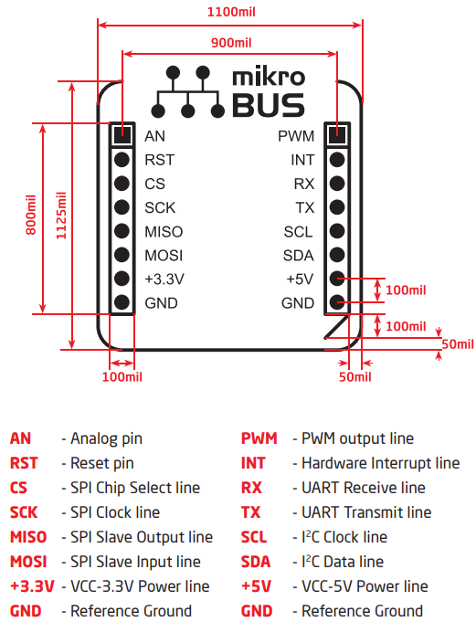
Why use mikroBUS?
The mikroBUS host connector consists of:
Two 1x8 female headers containing pins to the most likely target pin on any given click board
There are three groups of communication pins:
SPI, UART and I2C
Single pins for PWM, INT, AN, RST and CS
There are single pins for two power groups:
+5V and GND on left header
+3.3V and GND on right header
mikroBUS host fits all standardized click boards
Notes:
Pitch
The PM starts the presentation then turns it over to others who speak in turn
Each person should introduce themselves and speak to the design and status of their subsystem
My name is Dylan Dean, I am the Software Engineer and currently…
My name is Alfonso de la Morena, I am the Project Manager and currently…
My name is Mohamed Sghari, I am the Hardware Engineer and currently…

Slide 4
Project Overview
What did you design? Why?
What are the requirements?
What did you deliver? Does it do what it’s supposed to do?

Slide 5
Project Overview
Reasons
- IoT prototyping for Texas State Students in Dr Stapleton's class
Click Library support on forums for IoT prototyping of Hexiwear board
Project Motivation
Reasons
- IoT prototyping for Texas State Students in Dr Stapleton's class
Click Library support on forums for IoT prototyping of Hexiwear board
- Both the FRDM and the Hexiwear are NXP products

Slide 6
Project Overview
Notes:
Pitch
The PM starts the presentation then turns it over to others who speak in turn
Each person should introduce themselves and speak to the design and status of their subsystem
My name is Dylan Dean, I am the Software Engineer and currently…
My name is Alfonso de la Morena, I am the Project Manager and currently…
My name is Mohamed Sghari, I am the Hardware Engineer and currently…

Slide 7
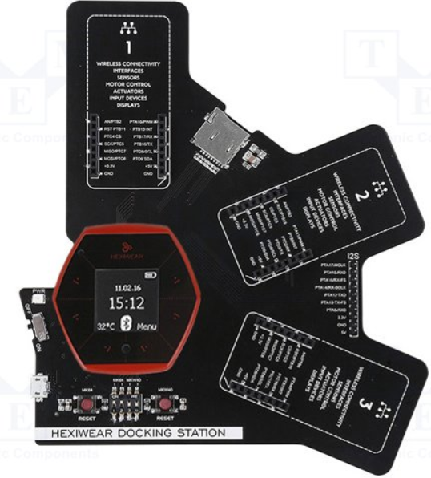
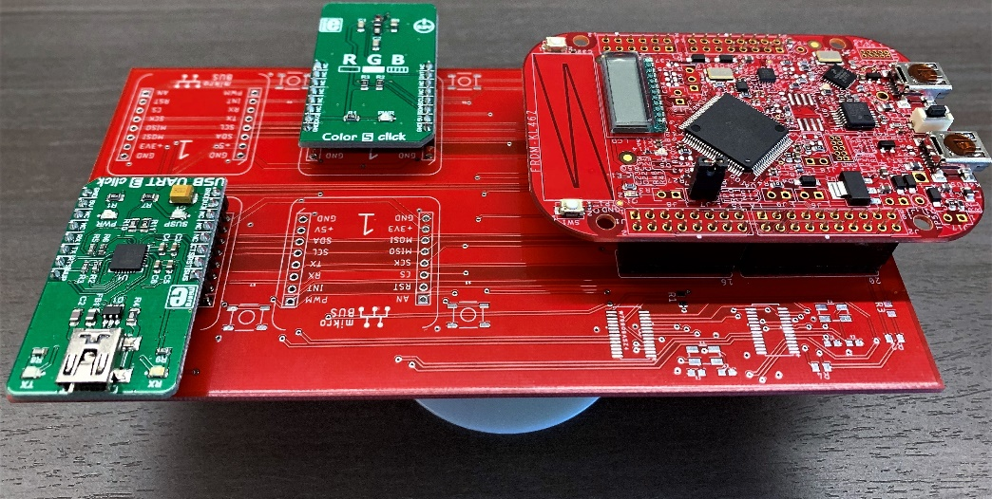
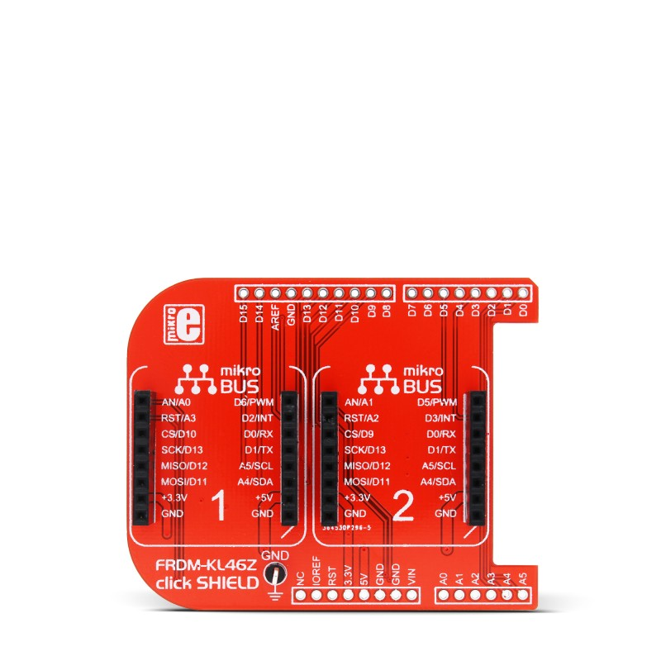
Project Motivation
NXP FRDM-KL46Z Board:
Click Sensor Hub
NXP Hexiwear:
Hexiwear Docking Station
NXP FRDM-KL46Z Board:
click SHIELD
Notes:
Why did we start this project? An attempt to Improve and expand upon current click SHIELD, and provide the microprocessors course at Texas State with an IoT development kit.

Slide 8
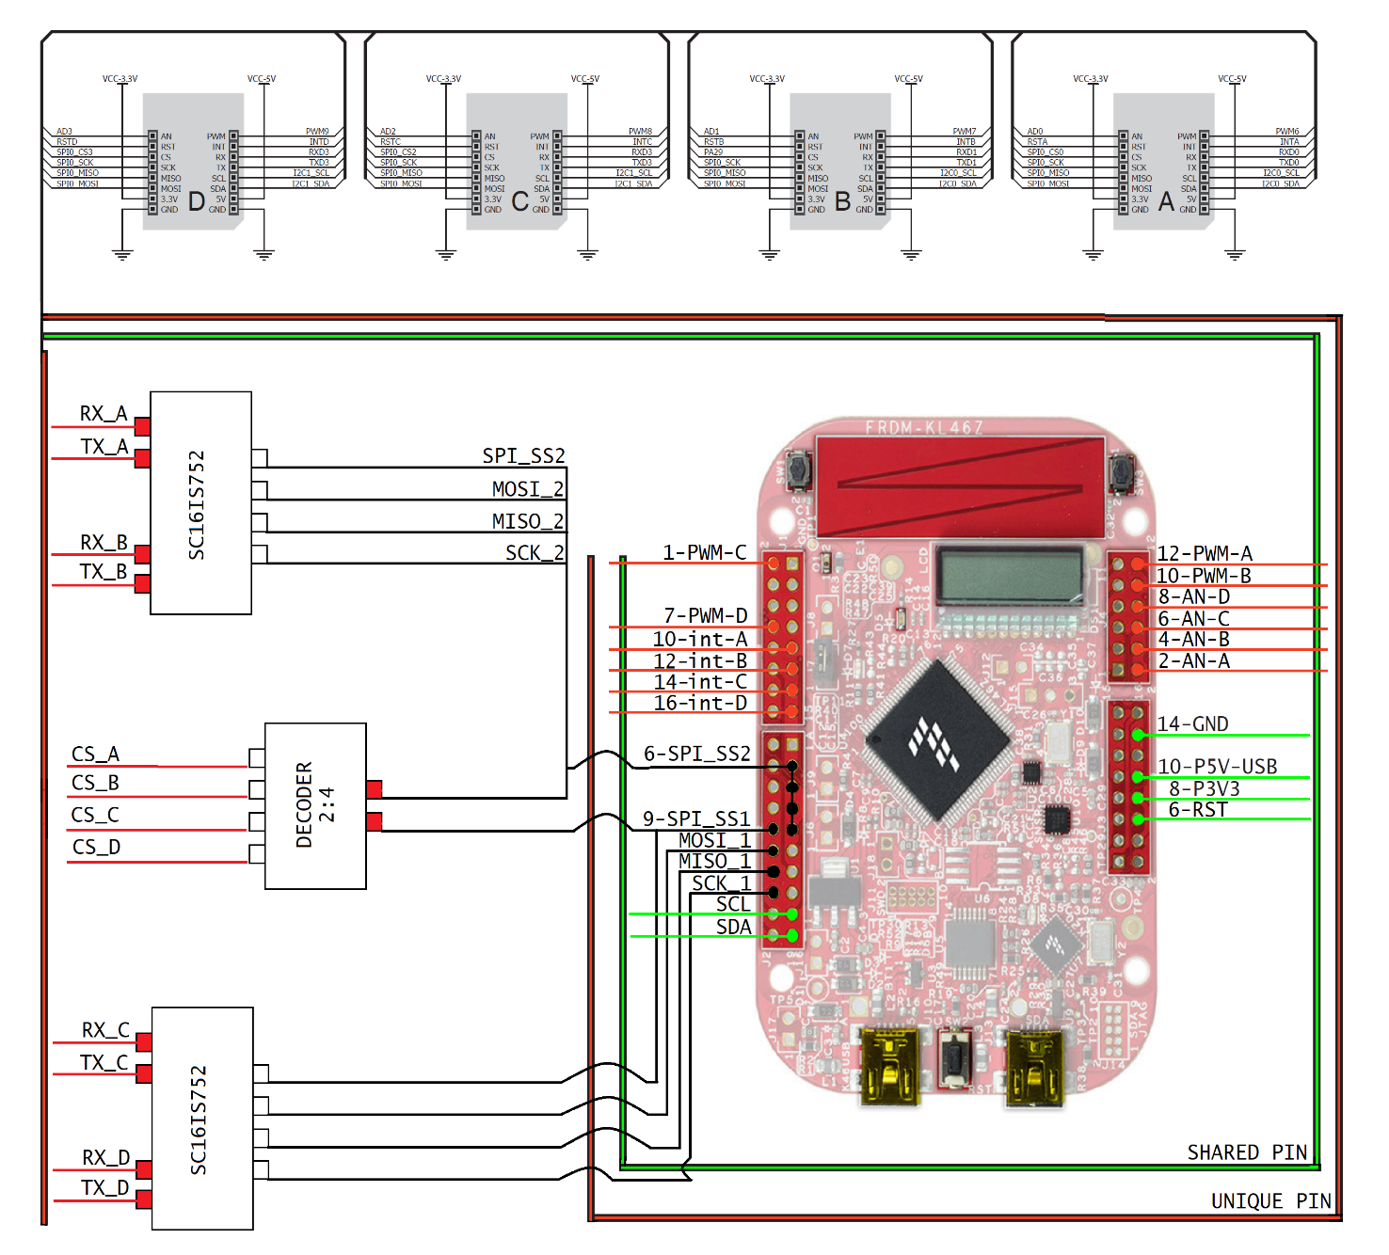

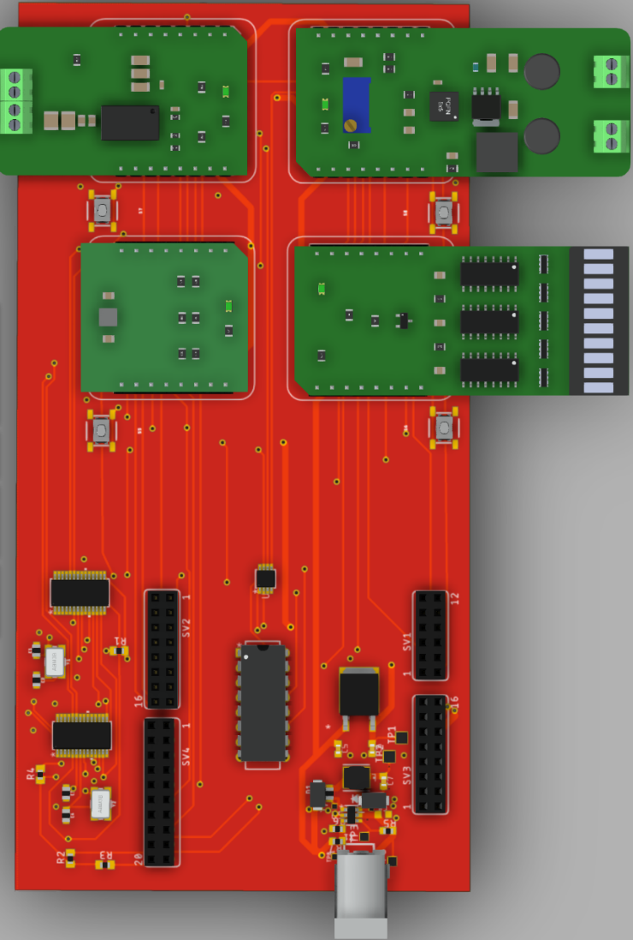
Hardware Development Process
Notes:
Pitch
The PM starts the presentation then turns it over to others who speak in turn
Each person should introduce themselves and speak to the design and status of their subsystem
My name is Dylan Dean, I am the Software Engineer and currently…
My name is Alfonso de la Morena, I am the Project Manager and currently…
My name is Mohamed Sghari, I am the Hardware Engineer and currently…

Slide 9
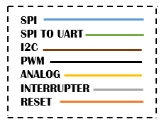
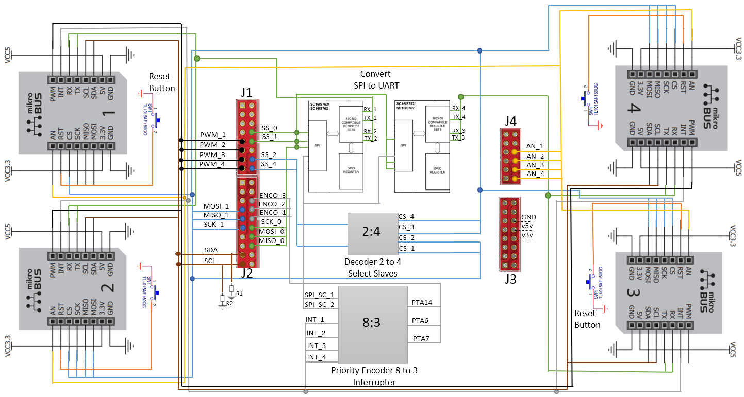
Hardware – First Board Design
Pros/Cons
Notes:
Pitch
The PM starts the presentation then turns it over to others who speak in turn
Each person should introduce themselves and speak to the design and status of their subsystem
My name is Dylan Dean, I am the Software Engineer and currently…
My name is Alfonso de la Morena, I am the Project Manager and currently…
My name is Mohamed Sghari, I am the Hardware Engineer and currently…

Slide 10
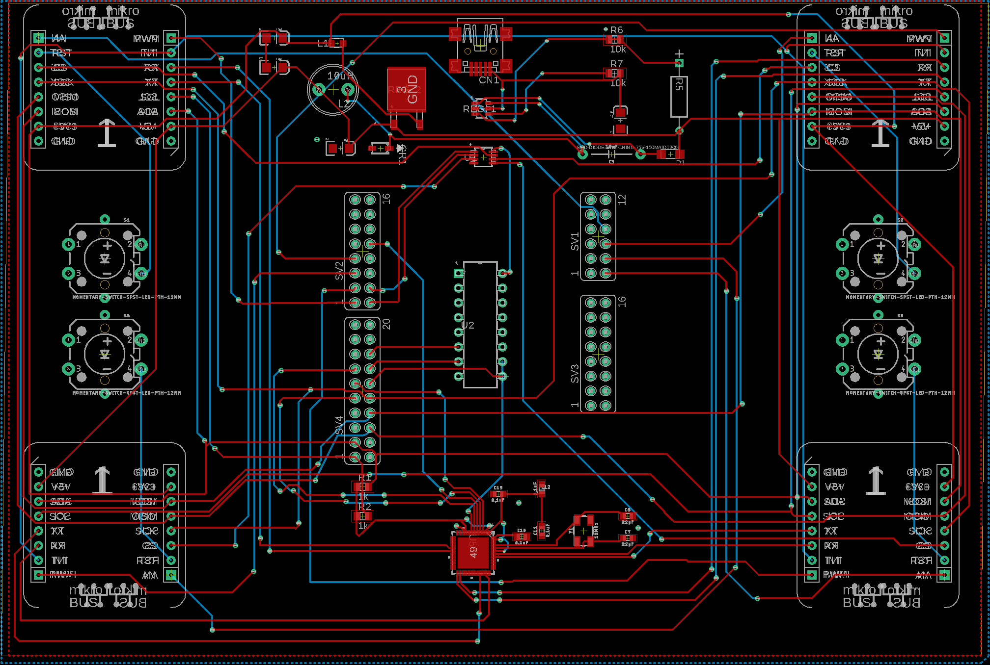
Hardware – Second Board Design
Pros/Cons
Notes:
Pitch
The PM starts the presentation then turns it over to others who speak in turn
Each person should introduce themselves and speak to the design and status of their subsystem
My name is Dylan Dean, I am the Software Engineer and currently…
My name is Alfonso de la Morena, I am the Project Manager and currently…
My name is Mohamed Sghari, I am the Hardware Engineer and currently…

Slide 11
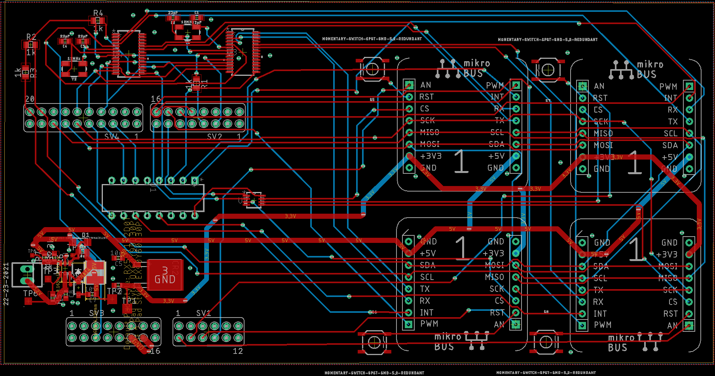
Hardware – Third Board Design
Pros/Cons
Notes:
Pitch
The PM starts the presentation then turns it over to others who speak in turn
Each person should introduce themselves and speak to the design and status of their subsystem
My name is Dylan Dean, I am the Software Engineer and currently…
My name is Alfonso de la Morena, I am the Project Manager and currently…
My name is Mohamed Sghari, I am the Hardware Engineer and currently…

Slide 12

Software Development Process
Notes:
Pitch
The PM starts the presentation then turns it over to others who speak in turn
Each person should introduce themselves and speak to the design and status of their subsystem
My name is Dylan Dean, I am the Software Engineer and currently…
My name is Alfonso de la Morena, I am the Project Manager and currently…
My name is Mohamed Sghari, I am the Hardware Engineer and currently…

Slide 13
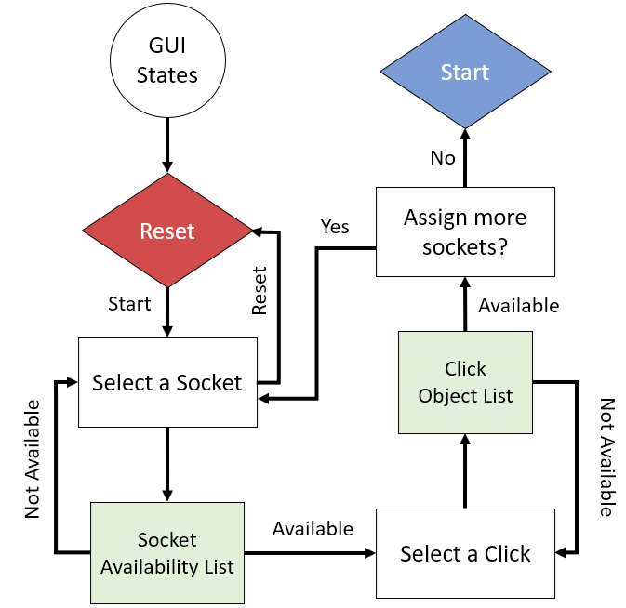
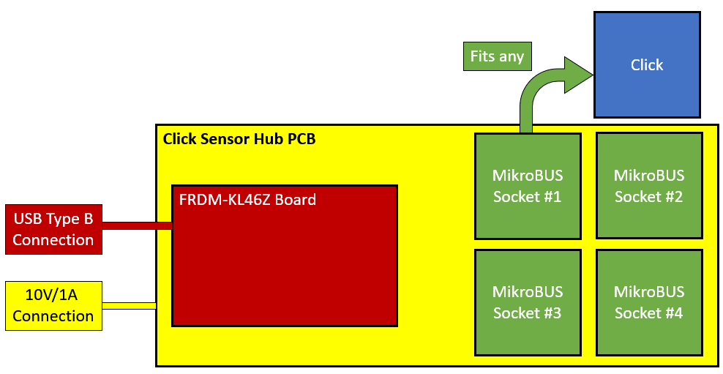
Click Socketing Process
Notes:
Pitch
The PM starts the presentation then turns it over to others who speak in turn
Each person should introduce themselves and speak to the design and status of their subsystem
My name is Dylan Dean, I am the Software Engineer and currently…
My name is Alfonso de la Morena, I am the Project Manager and currently…
My name is Mohamed Sghari, I am the Hardware Engineer and currently…

Slide 14
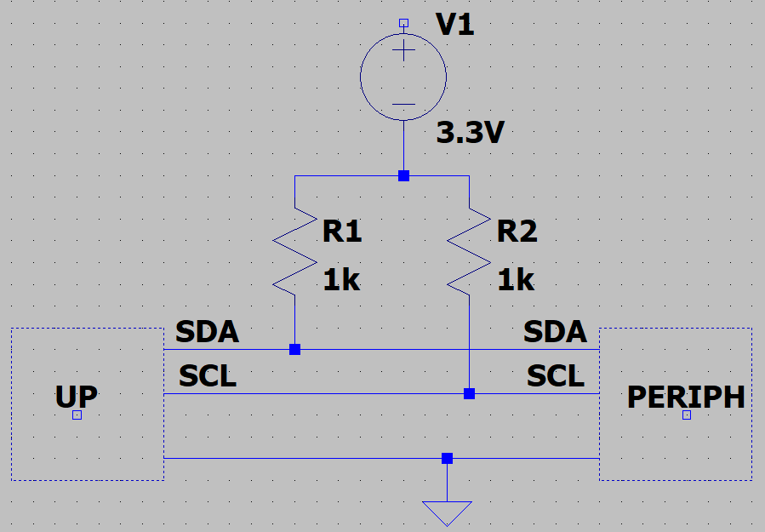
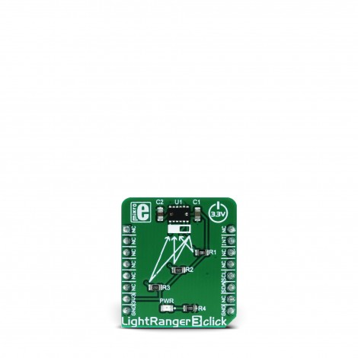
Example of I²C Click Coding
PuTTY output
Pull-Up Network
Notes:
Pitch
The PM starts the presentation then turns it over to others who speak in turn
Each person should introduce themselves and speak to the design and status of their subsystem
My name is Dylan Dean, I am the Software Engineer and currently…
My name is Alfonso de la Morena, I am the Project Manager and currently…
My name is Mohamed Sghari, I am the Hardware Engineer and currently…

Slide 15
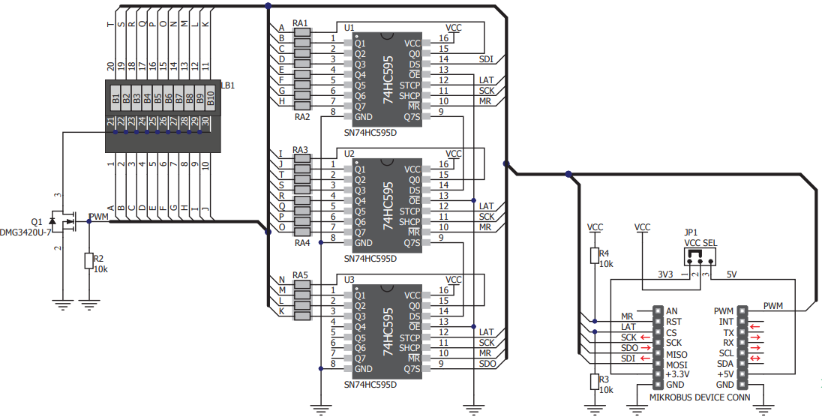
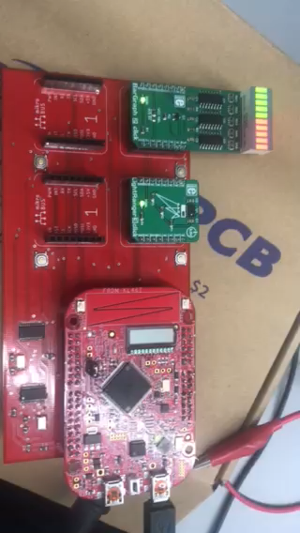
Example of SPI Troubleshoot
BarGraph2Click
Schematic
Suggestions?
Notes:
Pitch
The PM starts the presentation then turns it over to others who speak in turn
Each person should introduce themselves and speak to the design and status of their subsystem
My name is Dylan Dean, I am the Software Engineer and currently…
My name is Alfonso de la Morena, I am the Project Manager and currently…
My name is Mohamed Sghari, I am the Hardware Engineer and currently…

Slide 16
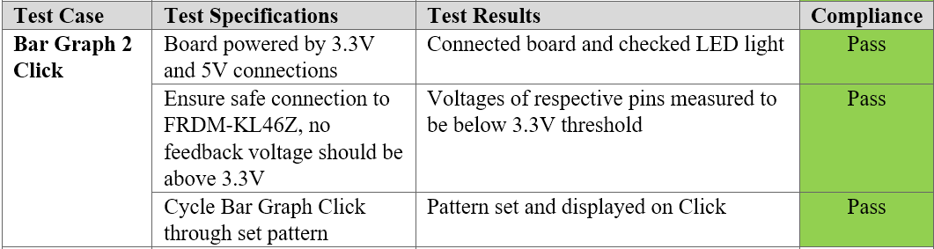
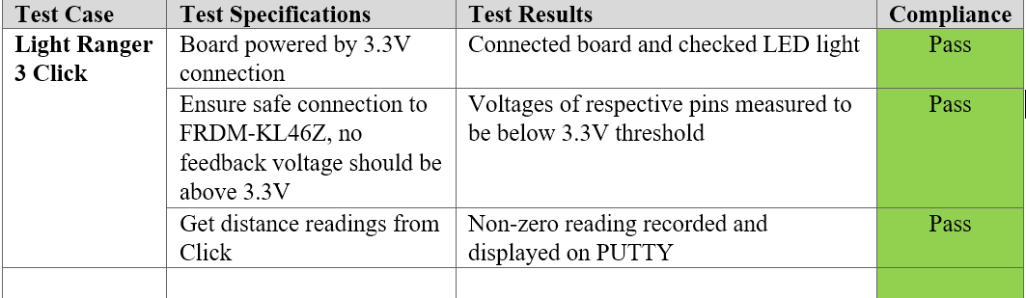
Examples of Click Validation
Note: I don’t like the wording in each cell, not descriptive enough. Thoughts?
Notes:
Pitch
The PM starts the presentation then turns it over to others who speak in turn
Each person should introduce themselves and speak to the design and status of their subsystem
My name is Dylan Dean, I am the Software Engineer and currently…
My name is Alfonso de la Morena, I am the Project Manager and currently…
My name is Mohamed Sghari, I am the Hardware Engineer and currently…

Slide 17
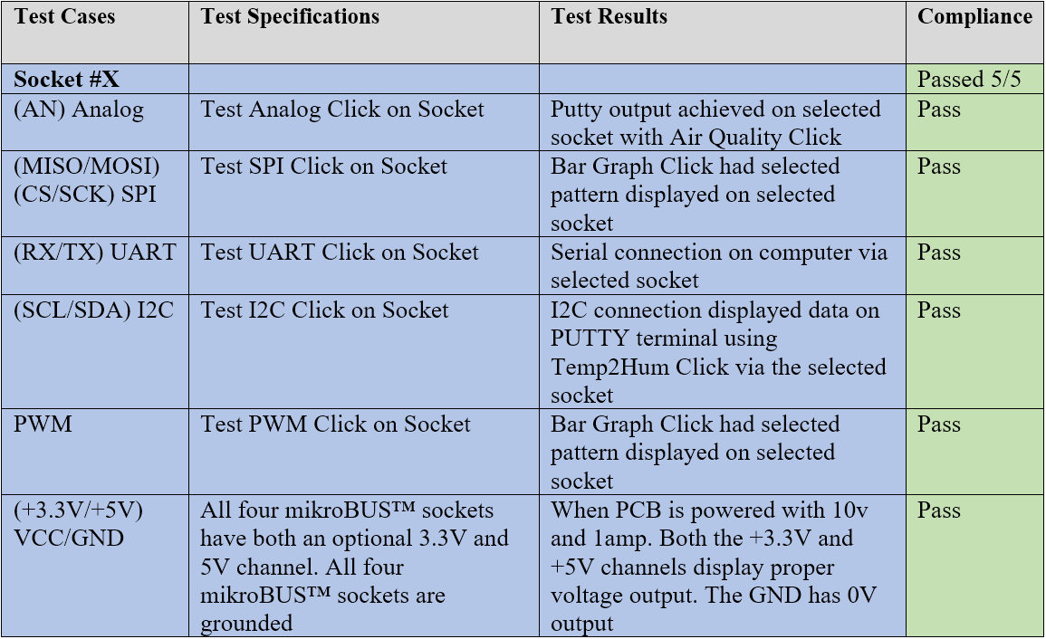
Example of Board/Socket Validation
Notes:
Pitch
The PM starts the presentation then turns it over to others who speak in turn
Each person should introduce themselves and speak to the design and status of their subsystem
My name is Dylan Dean, I am the Software Engineer and currently…
My name is Alfonso de la Morena, I am the Project Manager and currently…
My name is Mohamed Sghari, I am the Hardware Engineer and currently…

Slide 18
Acknowledgements
Sponsor: Dr. Kevin Kemp, NXP
Faculty Advisor: Dr. William Stapleton, TXST
Course Instructors: Mr. Hinkle and Dr. Welker, TXST
Notes:
Pitch
The PM starts the presentation then turns it over to others who speak in turn
Each person should introduce themselves and speak to the design and status of their subsystem
My name is Dylan Dean, I am the Software Engineer and currently…
My name is Alfonso de la Morena, I am the Project Manager and currently…
My name is Mohamed Sghari, I am the Hardware Engineer and currently…

Slide 19
BELOW SLIDES NOT PART OF FDR

Slide 20
Project Goals
# | Functional Deliverable | Status
1 | PCB fits 1 FRDM-KL46Z and 4 Click sensors simultaneously | Completed
2 | Click transmission over SPI | In-progress
3 | Click transmission over IIC | In-progress
4 | Click transmission over PWM | In-progress
5 | Click transmission over UART | In-progress
6 | Click transmission over Analog | In-progress
7 | Signals from 4 sockets transmitted simultaneously | Not started
8 | Example programs for 10 Clicks uploaded to GitHub | Not started
9 | Results from Clicks recorded and graphed | Not started
# | Stretch Goals | Status
1 | Website launched on Google Cloud Services | Completed
2 | Video and PDF tutorial launched on website | Not started

Slide 21
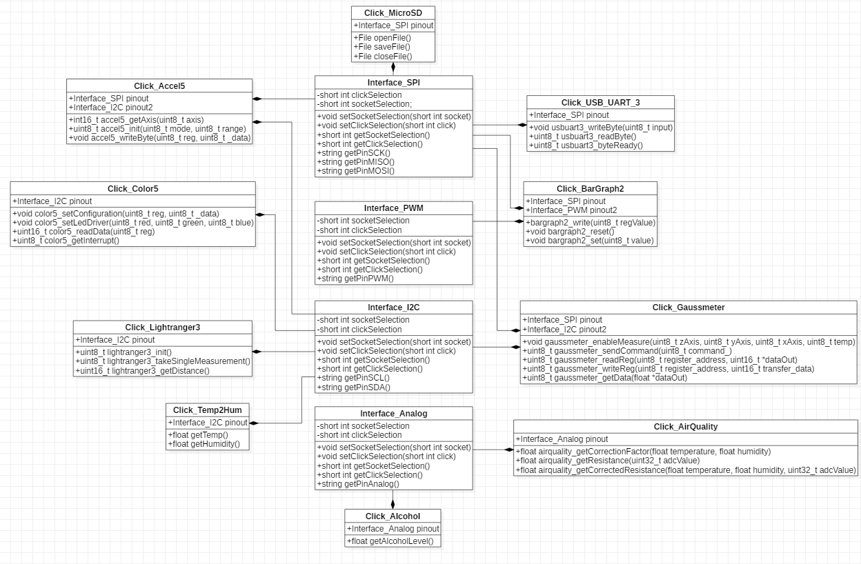
Product Design

Slide 22
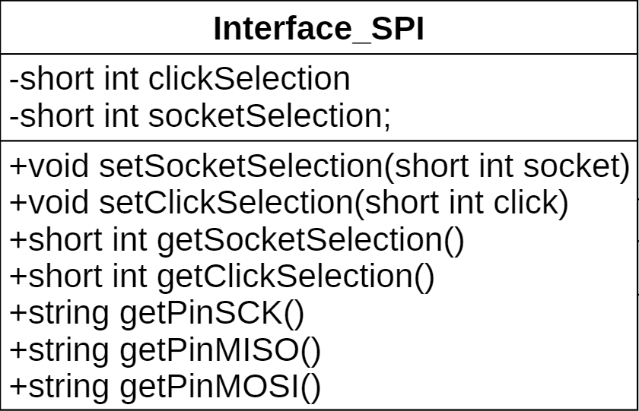
Product Design

Slide 23
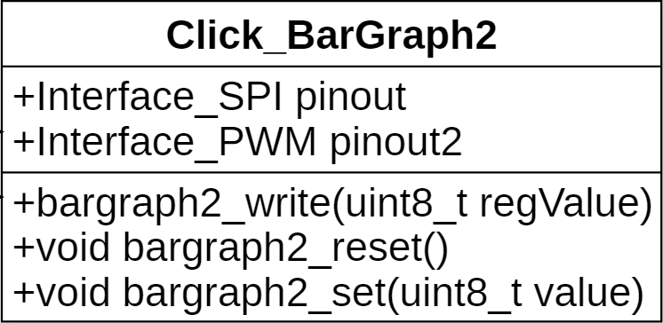
Product Design

Slide 24
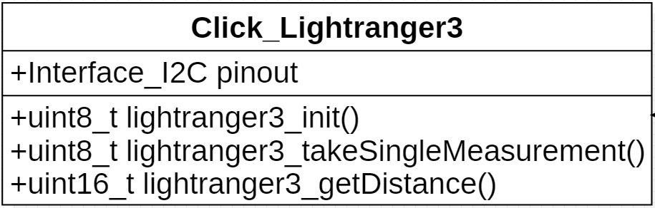
Product Design

Slide 25
Key Issues
# | Major Issues | P.O.A
1 | Board components delayed by Chinese new year | Focused on code/website
2 | Resistors ordered for power component in PCB too small | New order created for larger resistor (size not resistance)
3 | Example code for click sensors not easily available for Mbed platform | Use example code written for ICs that make up the Clicks
4 | Impossible to solder small components with available equipment | New order created for necessary soldering paste
5 | Behind schedule on board testing | Preparing future deliverables while waiting on components
Notes:
List the major issues and your plan to resolve.
Do not list – “not enough time”, “too much writing”, etc.

Slide 26
Additional Slides for Questions
# | Subject
1 | Service, Support and Maintenance
2 | SPI Connections
3 | Board Layout
4 | Schematic
5 | Shared/Unique Pins
6 | Complete Pinout
7 | Project Selected Clicks
8 | 3D Model

Slide 27
Return

Slide 28
The SPI devices disconnect their MISO pins when they are not selected
Each slave will need a separate SS line
SLAVE 1
SLAVE 2
SLAVE n
SCK
MOSI
MISO
SS
SCK
MOSI
MISO
SS
SCK
MOSI
MISO
SS
Master
SCK
MOSI
MISO
SS _ 1
SS _ 2
SS _ n
Return

Slide 29
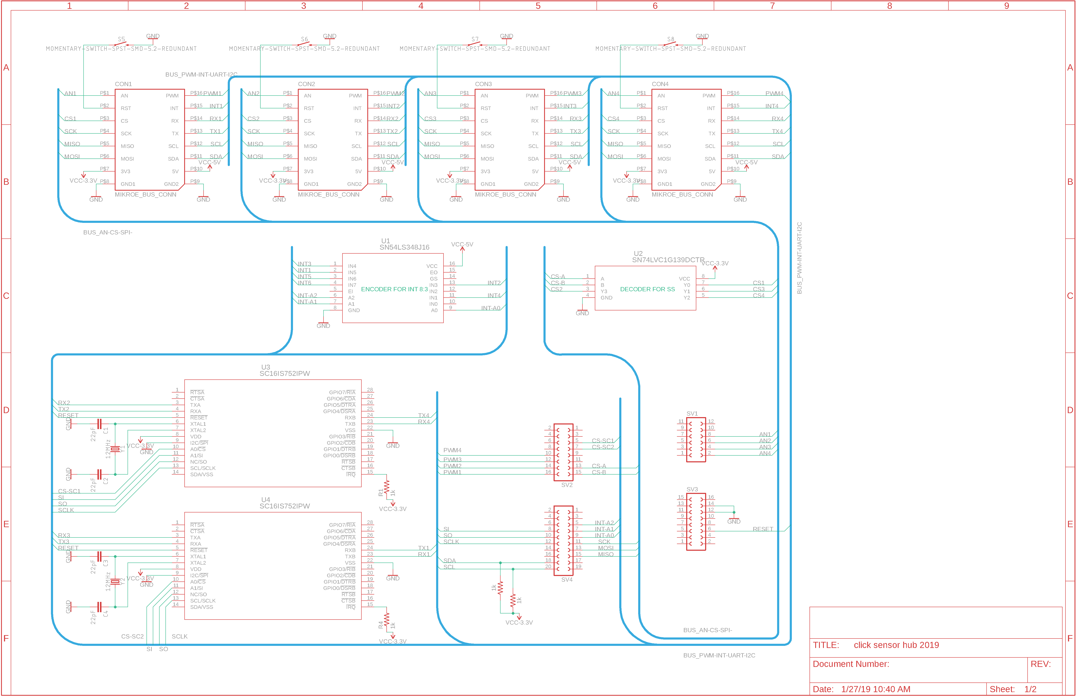
Return

Slide 30

Return

Slide 31
Return

Slide 32


Project Selected Clicks
CLICK NAME | Description and Interface | Interface | Power Supply | Price
Temp&Hum 2 Click | Measures a wide range of temperature and relative humidity values with a great accuracy | I2C | 3.3V | $16.00
USB UART 3 click | Adds USB 2.0 functionality | Serial | 3.3V & 5V | $15.00
Color 5 click | Integrated color sensing device | I2C | 3.3V & 5V | $16.00
BarGraph 2 Click | 10-segment bar graph display click, which uses a high-quality, multicolor bar graph LED display | PWM & SPI | 3.3V | $19.00
Accel 5 click | Triaxial accelerometer sensor | I2C & SPI | 3.3V | $19.00
Gaussmeter click | Gaussmeter used for measuring the magnetic field in X, Y and Z axes | I2C & SPI | 3.3V | $19.00
LightRanger 3 Click | Accurate distance measurement based on a ToF (Time of Flight) measurement principle | I2C | 3.3V | $24.00
Alcohol Click | Portable alcohol detector, breathalyzer for estimating BAC | Analog | 3.3V | $15.00
Air Quality Click | detecting a variety of gases that impact air quality in homes and offices | Analog | 3.3V | $16.50
microSD click | A microSD card slot for microSD cards used as a mass storage media for portable devices | SPI | 3.3V | $16.00
Return

